Slide 1





Next Gen Employability Program
NEXT GEN EMPLOYABILITY PROGRAM
Creating a future-ready workforce
Team Members
College Name
Student Name : Kavin Brylo M
Student ID : au963521104032
Stella Mary's College of Engineering
Notes:
1

Slide 2

Next Gen Employability Program
CAPSTONE PROJECT SHOWCASE
Project Title
Car Rentals Application with Django Framework
Abstract | Problem Statement | Project Overview | Proposed Solution | Technology Used | Modelling & Results | Conclusion

Slide 3
Next Gen Employability Program
Abstract
The car rental application is a digital platform designed to facilitate the process of renting vehicles. It provides users with a convenient interface to search for available cars, make reservations, manage bookings, and handle payments securely. The application streamlines the rental process for both customers and rental agencies, offering features such as real-time availability, GPS navigation, and customer support. With its user-friendly design and comprehensive functionality, the car rental application aims to enhance the overall experience of renting a vehicle.
Source :

Slide 4
Next Gen Employability Program
Problem Statement
The problem statement for the car rental application revolves around addressing the inefficiencies and inconveniences associated with traditional car rental processes. Specifically, it aims to streamline the rental experience by providing a digital platform that offers convenience, accessibility, and efficiency for both customers and rental agencies. Key challenges include long wait times, limited vehicle availability, complex reservation procedures, unclear pricing structures, and potential issues with vehicle maintenance and cleanliness. The goal is to develop a solution that leverages technology to overcome these challenges and create a seamless and user-friendly car rental experience for all stakeholders involved.
Source :

Slide 5
Next Gen Employability Program
Project Overview
The car rental application is a comprehensive digital platform designed to facilitate the process of renting vehicles. It offers a user-friendly interface accessible via web or mobile devices, enabling customers to search for available cars, make reservations, manage bookings, and handle payments securely. The application integrates real-time inventory management, allowing users to check vehicle availability instantly. It also includes features such as GPS navigation, which assists renters in locating pickup/drop-off points and navigating during their rental period. Additionally, the application provides customer support channels to address any queries or issues promptly. Overall, the car rental application aims to simplify and enhance the rental experience for both customers and rental agencies through efficient technology-driven solutions.
Source :

Slide 6
Next Gen Employability Program
Proposed Solution
The proposed solution for the car rental application includes several key features aimed at improving the overall rental experience for customers and rental agencies:
1.User-friendly Interface
2.Real-time Availability
3.Secure Booking and Payment
4.GPS Navigation
5.Customer Support
6.Transparent Pricing
7.Ratings and Reviews
Source :

Slide 7


Next Gen Employability Program
Technology Used
Front-end
Back-end
Source :

Slide 8
Next Gen Employability Program
Modelling & Results
For modeling the car rental application, a typical approach involves the following steps:
1.Data Collection
2.Data Preprocessing
3.Feature Engineering
4.Model Selection
5.Model Training
6.Evaluation
7.Deployment
As for results, the car rental application aims to achieve several key outcomes:
1.Improved Customer Experience
2.Optimized Operations
3.Enhanced Revenue
4.Fraud Prevention
5.Data-driven Insights
Source :

Slide 9
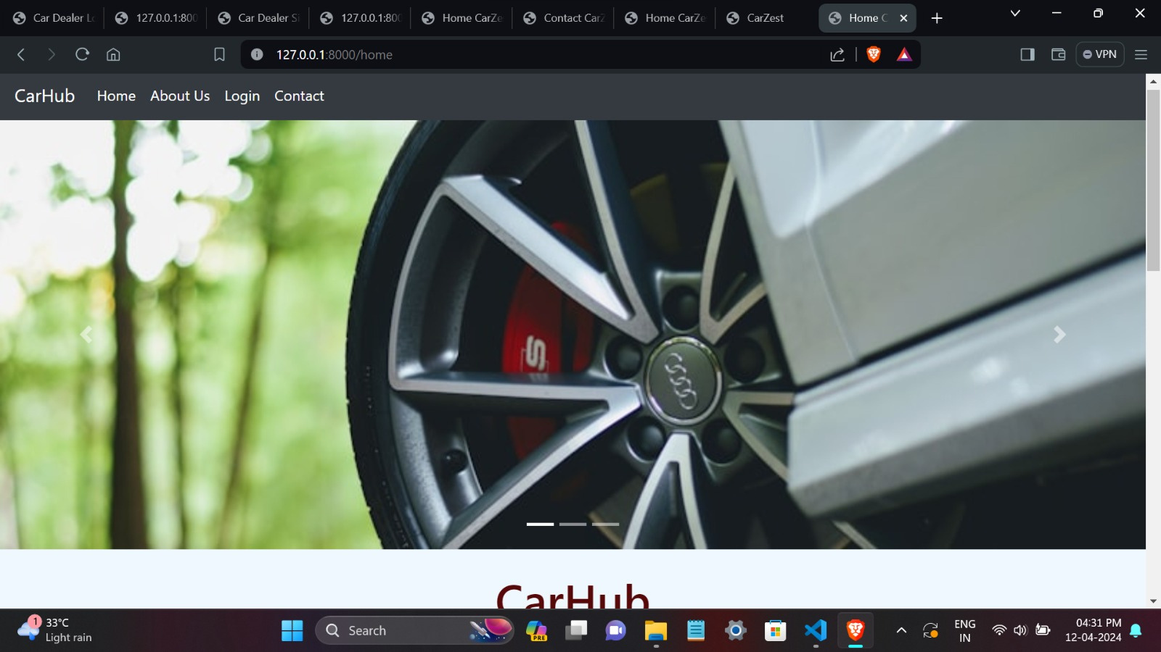
Next Gen Employability Program
Homepage

Slide 10
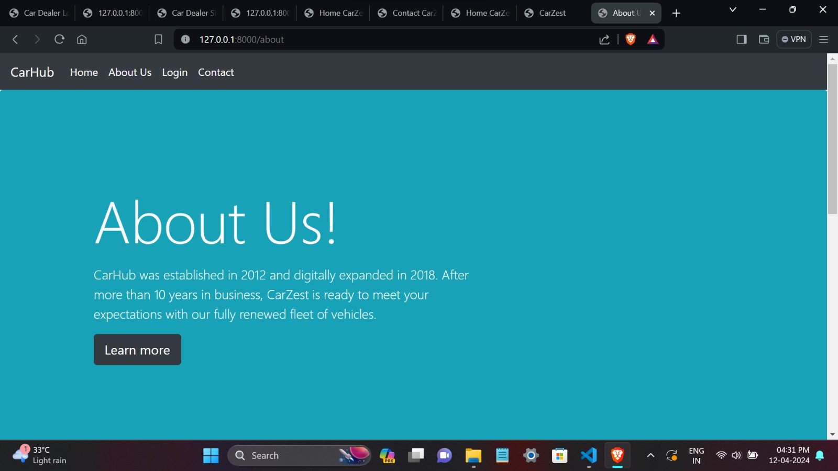
Next Gen Employability Program
About-Us-Page

Slide 11
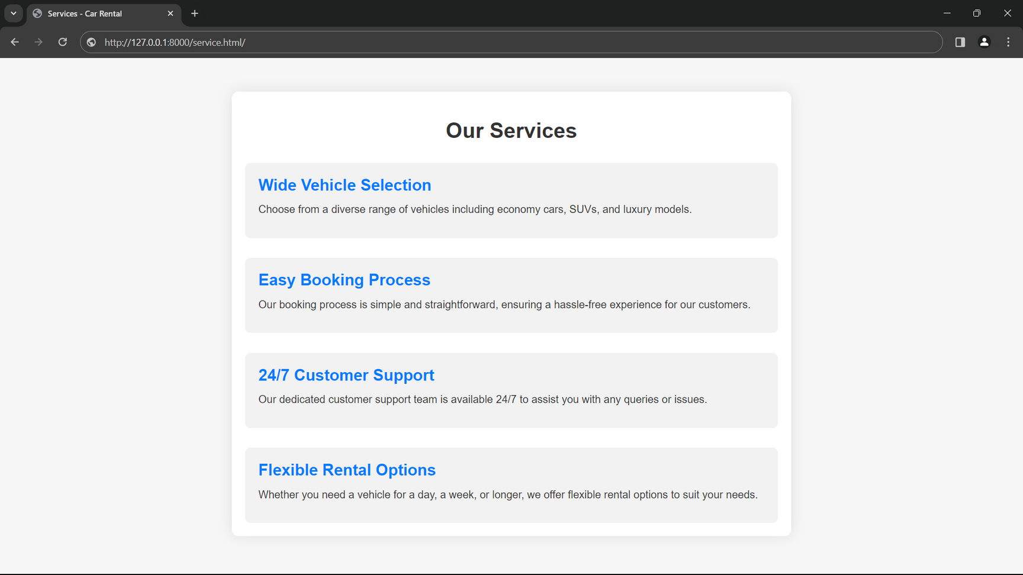
Next Gen Employability Program
Service-Page

Slide 12
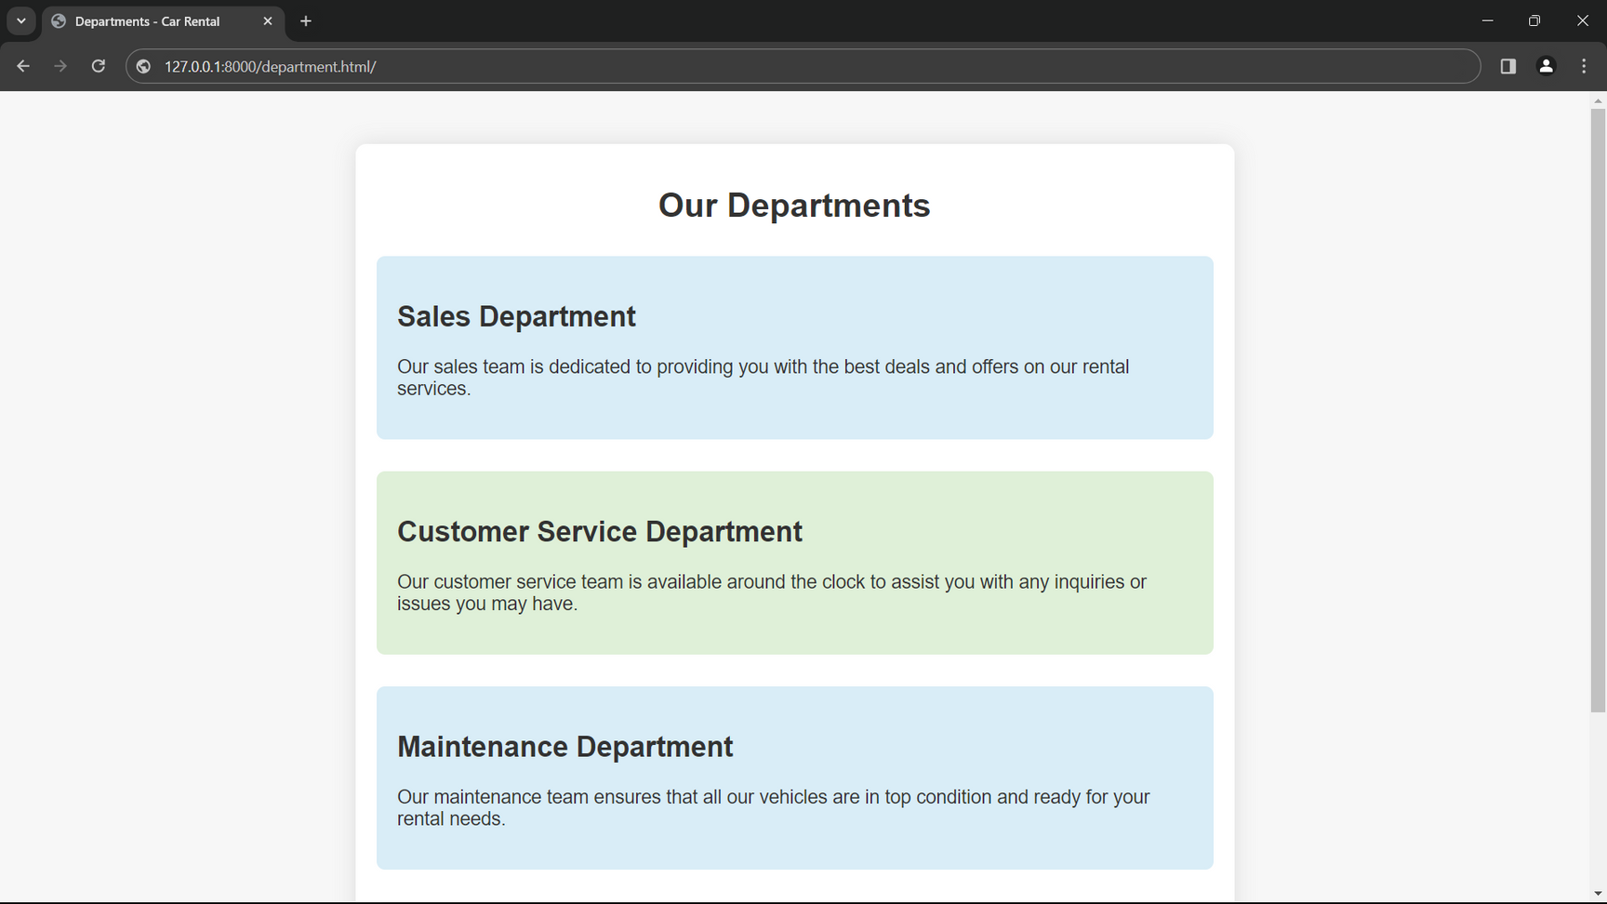
Next Gen Employability Program
Departments-Page

Slide 13
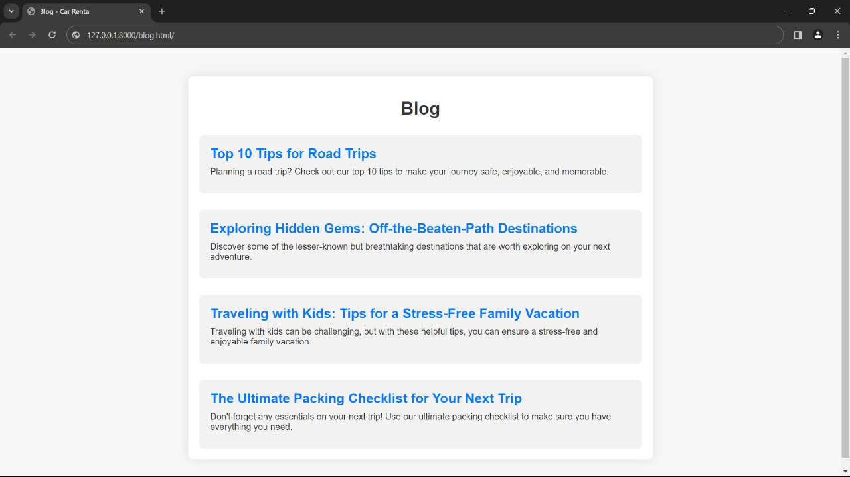
Next Gen Employability Program
Blog-Page

Slide 14
Next Gen Employability Program
Future Enhancements:
Future enhancements for the car rental application could include:
1.Integration of Electric Vehicles (EVs)
2.Predictive Maintenance
3.Enhanced Mobile App Features
4.Subscription Models
5.Partnerships and Loyalty Programs
6.Environmental Impact Tracking
7.Blockchain Integration
8.AI-Powered Chatbots

Slide 15
Next Gen Employability Program
Conclusion
In conclusion, the car rental application represents a pivotal solution in revolutionizing the way people access and utilize rental vehicles. By leveraging cutting-edge technology and innovative features, the application streamlines the rental process, enhances convenience, and improves overall customer satisfaction. Through real-time availability updates, secure booking and payment systems, GPS navigation, and responsive customer support, the application delivers a seamless experience for users.
Moreover, with future enhancements such as integrating electric vehicles, predictive maintenance, and subscription models, the application continues to evolve to meet the changing needs and preferences of customers while staying ahead in the competitive rental market.
Ultimately, the car rental application not only facilitates efficient vehicle rentals but also contributes to environmental sustainability, fosters partnerships, and embraces emerging technologies to deliver value-added services. As such, it stands as a testament to the transformative power of technology in reshaping traditional industries and enhancing the overall mobility experience for users.
Source :

Slide 16
Next Gen Employability Program
Thank You!
Notes:
Thank You !!

